Slide 1

Final Project
IMPACT OF COVID19 ON ABC COMPANY’S PARCEL DELIVERY BUSINESS

Slide 2

Project members
Jatinder Singh
Jatin Bajaj
Simran

Slide 3

Introduction
The impact of the COVID-19 pandemic on Canadian businesses has been varied. While some have seen success with the rise of online shopping, others have faced difficulties. ABC Company, which specializes in parcel delivery, caters to clients across different industries, each grappling with their own set of challenges during this unprecedented time.
Pre-Covid Observation Period : 1st week of 2020 to 11th week of 2020
COVID Observation Period : 12th week of 2020 to 53rd week of 2020

Slide 4

Evaluation Of Business Questions

Slide 5
How did the COVID-19 pandemic impact ABC Company’s parcel business?
2019 to 2020: The total volume increased by approximately 48.56%.
COVID-19 had a positive impact on ABC Company’s parcel business, contributing to the overall growth in volume

Slide 6
When were customer volumes first impacted by COVID-19?
First Covid Impacted Week: Week 13
The lowest recorded count occurred in the 14th week.
There was an initial significant drop in customer volume, signaling the beginning of the COVID-19 impact on parcel business operations.

Slide 7
Events Contributed within COVID TimeLine:
Disruptions in the worldwide supply chain.
Rise in internet shopping.
Shift to remote work and educational setups. Increased focus on health and safety.
Efforts to vaccinate against COVID-19.
Effects of severe weather conditions.
In March-April 2020, there was a notable increase in panic purchasing and hoarding of essential items.

Slide 8
How did COVID-19 impact peak season in 2020?
 | 2019 Peak Season | 2020 Peak Season
Enterprise | 12693099 | 14462302
Large | 1194225 | 1651671
Medium | 1810061 | 2254732
Small | 712688 | 1074202

Slide 9
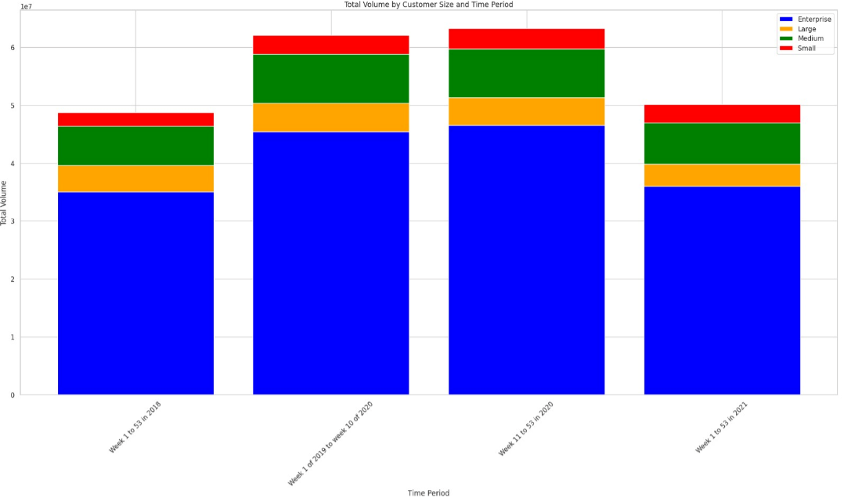
How has COVID affected companies in the different customer groups (Enterprise, Large, etc.)?
Enterprise and Large groups experienced growth in 2020 compared to the previous years.
Medium customer volumes showed consistent growth over the years, with a peak in 2020.
Small customer volumes increased from 2018 to 2019 but declined in 2020 and 2021.

Slide 10
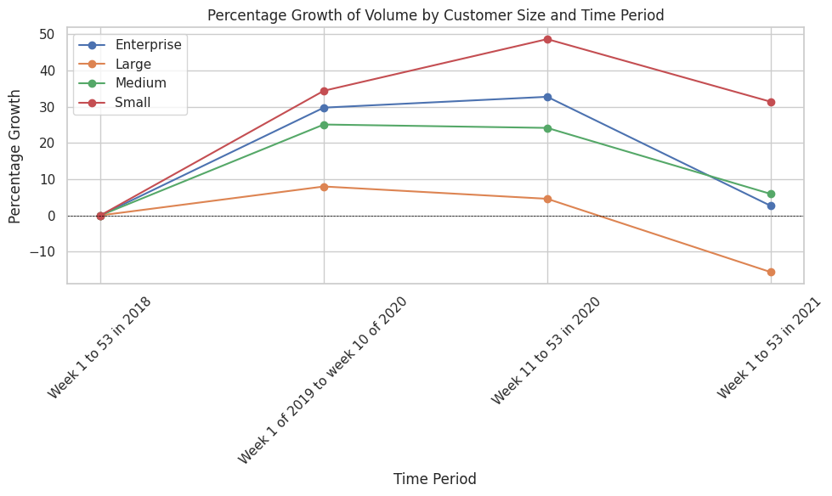
What percent of each customer group is growing, moderately growing, and declining during the COVID observation period?
Enterprise group is growing moderately
Large group is declining moderately
Medium group is declining moderately
Small group is increasing steadily

Slide 11
What percent of each customer group are new customers during the COVID observation period?

Slide 12
What was the overall impact of COVID on volumes and revenue by customer group?
Customer | Volume change (%) | Revenue Change (%)
Enterprise | 19.72% | 39.36%
Large
Medium
Small

Slide 13

Thank you

